Slide 1
Utility, consumer preference, and Indifference curve

Slide 2
Consumer preference
Fundamental assumptions on CP
Utility
Law of diminishing marginal Utility

Slide 3

What consumer prefers?

Slide 4
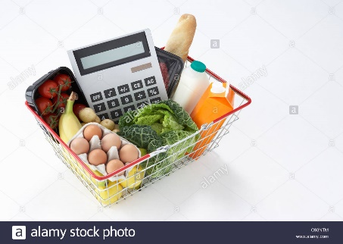

Preferences
Every consumer has a set of likes and dislikes, desires, and tastes, called preferences over all goods and services.
Bundle A
Bundle B

Slide 5
Can compare two combinations or bundle of goods and services in terms of better, worse, or the same
Strictly preferred (>) → x>y
Indifferent (~) → x ~ y
Weakly preferred (≥) → x ≥ y ( at least as much as )

Slide 6
Three axioms
Fundamental assumptions to ensure internal consistency:
Completeness :– the consumer can compare any bundles and render a preferred or indifferent judgment.
Reflexivity :– this identity condition says that the consumer is indifferent when comparing a bundle to itself.
Transitivity :– if bundle A is preferred to bundle B and bundle B is preferred to bundle C then bundle A must be preferred to bundle C.

Slide 7
Utility
A curve that showing combination of two goods that gives the consumer equal satisfaction and utility
Utility is the want satisfying power of commodity
Utility is subjective
Utility is relative-varies with time , place and person
Cardinal and ordinal utility

Slide 8
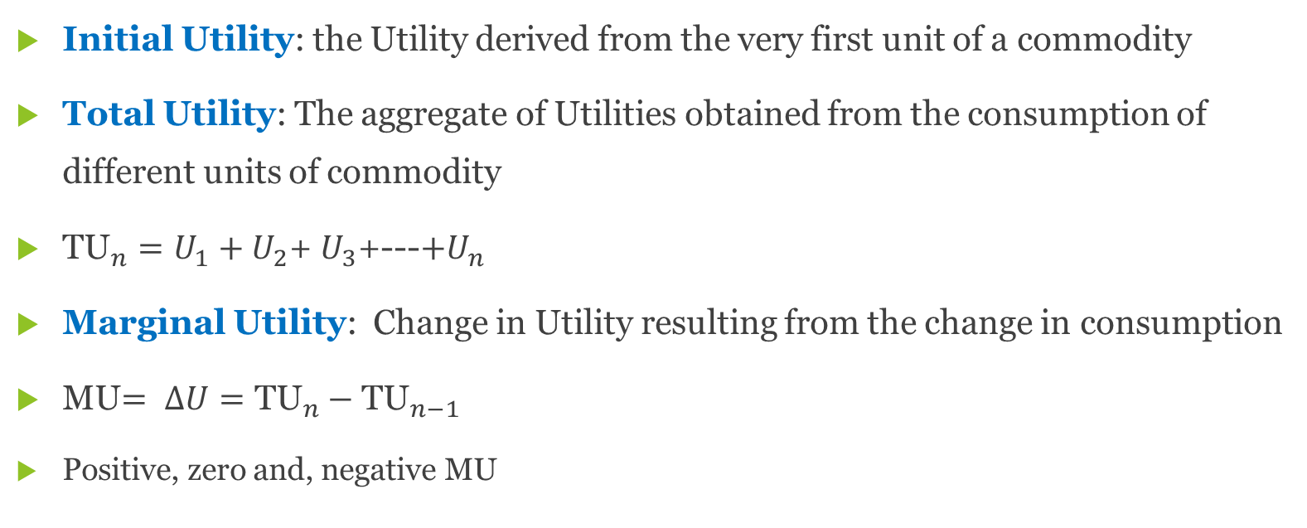
Concepts of utility
Initial Utility: the Utility derived from the very first unit of a commodity
Total Utility: The aggregate of Utilities obtained from the consumption of different units of commodity
${\text{TU}}_{n}=U_{1}+U_{2}$+ $U_{3}$+---${+U}_{n}$
Marginal Utility: Change in Utility resulting from the change in consumption
MU$= ∆U={\text{TU}}_{n}−{\text{TU}}_{n−1}$
Positive, zero and, negative MU

Slide 9
Law of diminishing marginal utility
The law states that the additional benefit which a person derives from a given increase in stock of a thing diminishes with every increase in the stock that he already has, ceteris paribus
as consumption increases the marginal utility derived from each additional unit declines
Utility can be measured
MU of money remains constant
Every unit of commodity remains the same with respect to size and quality
Continuous consumption
Suitable quantity of the commodity is consumed
There is no change in income, tastes, character, fashion and habits of the consumer

Slide 10
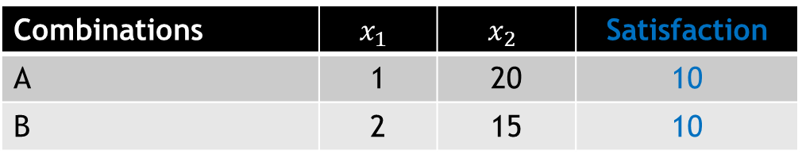

Indifference Curve
An indifference curve (IC) shows the different combinations of $x_{1}$ and $x_{2}$ that yield equal satisfaction to the consumer
Combinations | $$x_{1}$$ | $$x_{2}$$ | Satisfaction
A | 1 | 20 | 10
B | 2 | 15 | 10

Slide 11
Assumptions
An ordinal approach
Rationality of consumer
Non-satiety: consumer is not oversupplied with goods in question
Transitivity of choice
Consistency of choice
Diminishing marginal rate of substitution

Slide 12
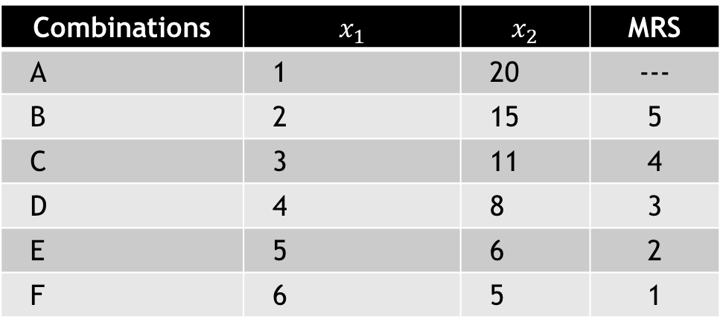
IC schedule
Combinations | $$x_{1}$$ | $$x_{2}$$ | MRS
A | 1 | 20 | ---
B | 2 | 15 | 5
C | 3 | 11 | 4
D | 4 | 8 | 3
E | 5 | 6 | 2
F | 6 | 5 | 1

Slide 13
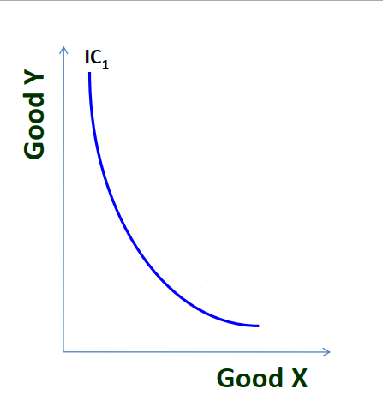
Graphical representation

Slide 14
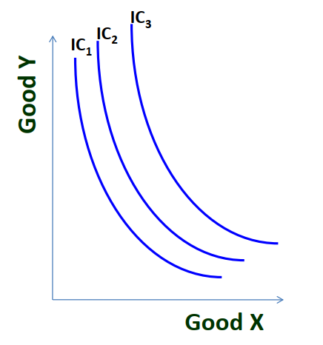
IC Map

Slide 15
Marginal rate of substitution
The rate at which an individual must give up good 1 in order to obtain one more unit of good 2, while keeping their overall satisfaction level constant
MRS keeps declining since consumer has more and more units of one good , he gives up less units of other goods.

Slide 16
Properties of IC
Negative slope
Always convex to the origin
Two IC never intersect each other
Higher IC shows higher level of satisfaction

Slide 17
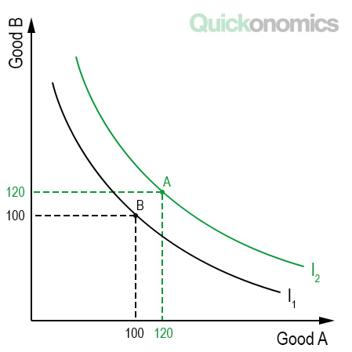
Properties of IC
Higher IC shows higher level of satisfaction
More goods are preferred to less goods
Higher IC contains more of either one or both goods
C
45
140

Slide 18
Properties of IC
Downward sloping
Implies that when the amount of one good in combination is increased, the amount of other good is reduced
This is essential if the level of satisfaction is to remain the same on an IC
Convex to the origin
Two commodities are imperfect substitute for each other
MRS between the two goods decreases when consumer moves along an IC

Slide 19
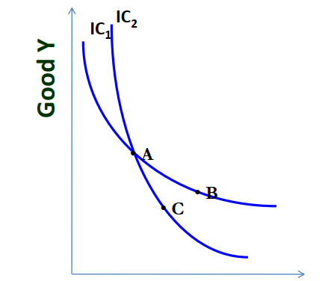
Two ICs never intersect each other

Slide 20
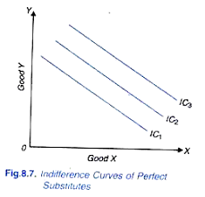
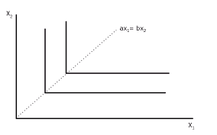
Two extreme conditions
When two goods are perfect substitute, IC will be a straight line
When two goods are complementary, IC will be L shaped

